Slide 1


Session 4 Computing and parallel computing

Slide 2

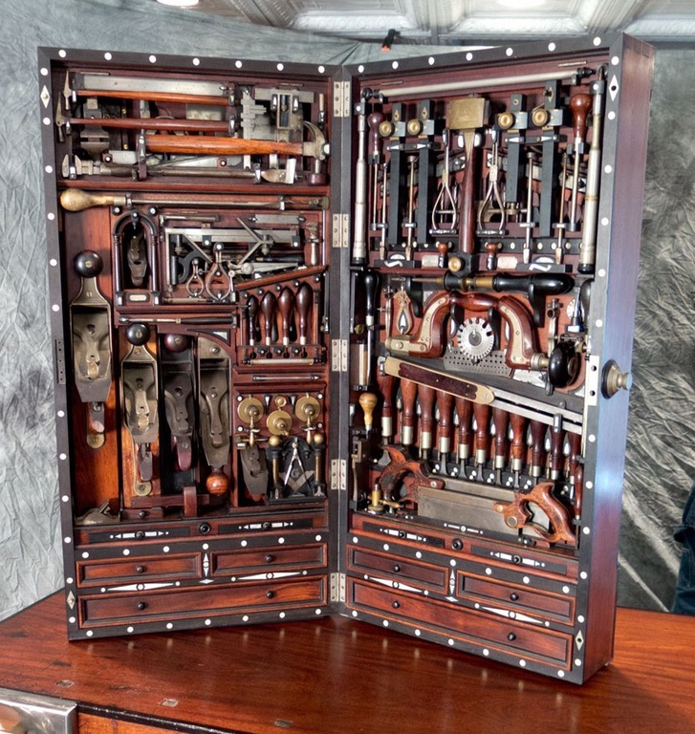
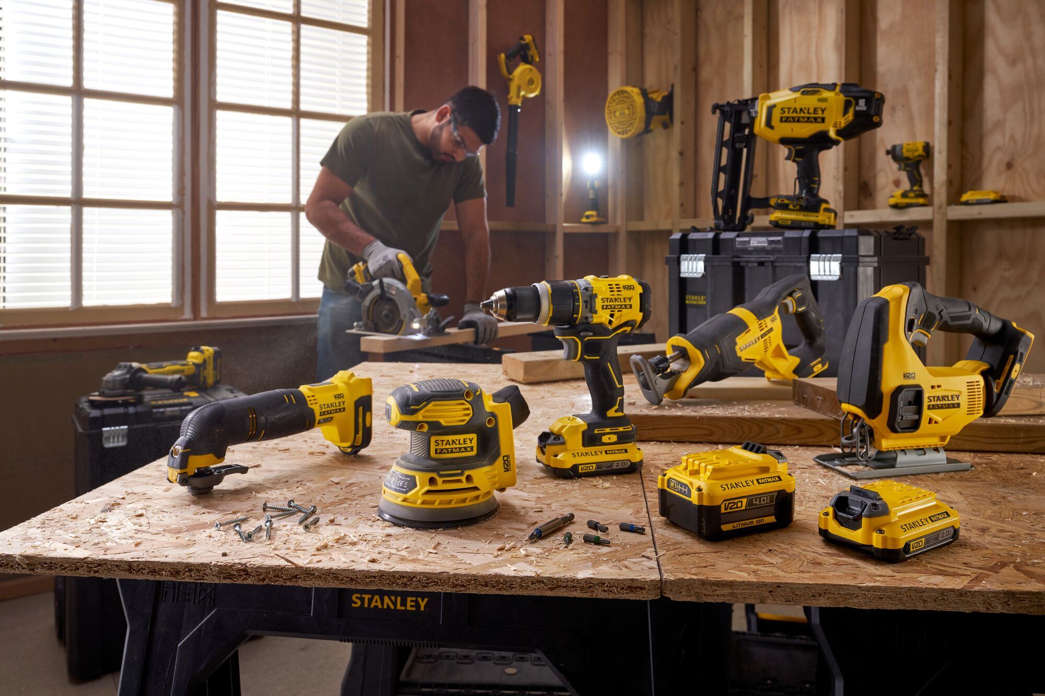
Software = tools…
Old reliable, easy to use
Good for small jobs
Fancy, complicated, takes lot of practice
For small precision work (specialists)
Power tools, do big jobs easy, automation, less control, less precision

Slide 3
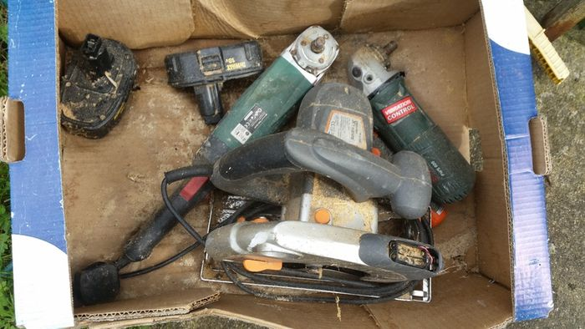



Software = tools…
Old, obsolete, abandoned Not updated in a while,
missing dependencies
Straight up broken, sometimes fixable, Mostly not worth the effort
Pet projects, often hyped up in paper
No real practical use, often doesn’t even
do the job it advertises it does.
5% more efficient than all other tools*
*only tested on one outlier dataset with peculiar characteristics

Slide 4
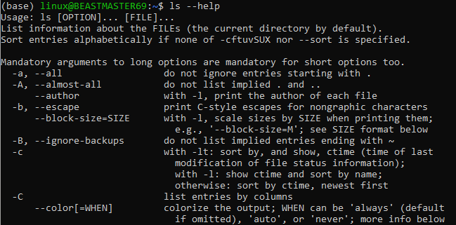
Available “software”

Slide 5
Available “software”
Parameters
Boolean = True/False
Integer = 1,2,3,N
File = /location/to/your/file.txt
Text = “BlastN”, “SemiGlobal”,”ML”,”Parsimony”
Lorenza
--Trees [string]
--Osteology [file]
--Draw [integer]
--Eager [boolean]
Tessa
--PCR
--Make_dresses
--DNA_extraction
--Eager
Casey
--Osteology
--Cast_dark_magic
--Archeology
--Eager

Slide 6
Available “software”
Lorenza
--Trees
--Osteology
--Draw
--Eager
Tessa
--PCR
--Make_dresses
--DNA_extraction
--Eager
Casey
--Osteology
--Cast_dark_magic
--Archeology
--Eager

Slide 7
Available “software”
Lorenza
--Trees
--Osteology
--Draw
--Eager
Tessa
--PCR
--Make_dresses
--DNA_extraction
--Eager
Casey
--Osteology
--Cast_dark_magic
--Archeology
--Eager

Slide 8
Available “software”
Lorenza
--Trees
--Osteology
--Draw
--Eager
Tessa
--PCR
--Make_dresses
--DNA_extraction
--Eager
Casey
--Osteology
--Cast_dark_magic
--Archeology
--Eager

Slide 9
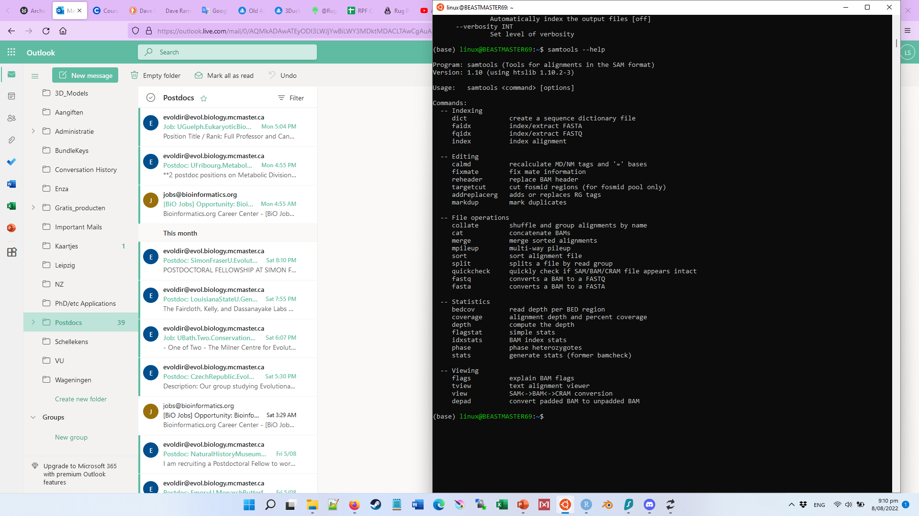
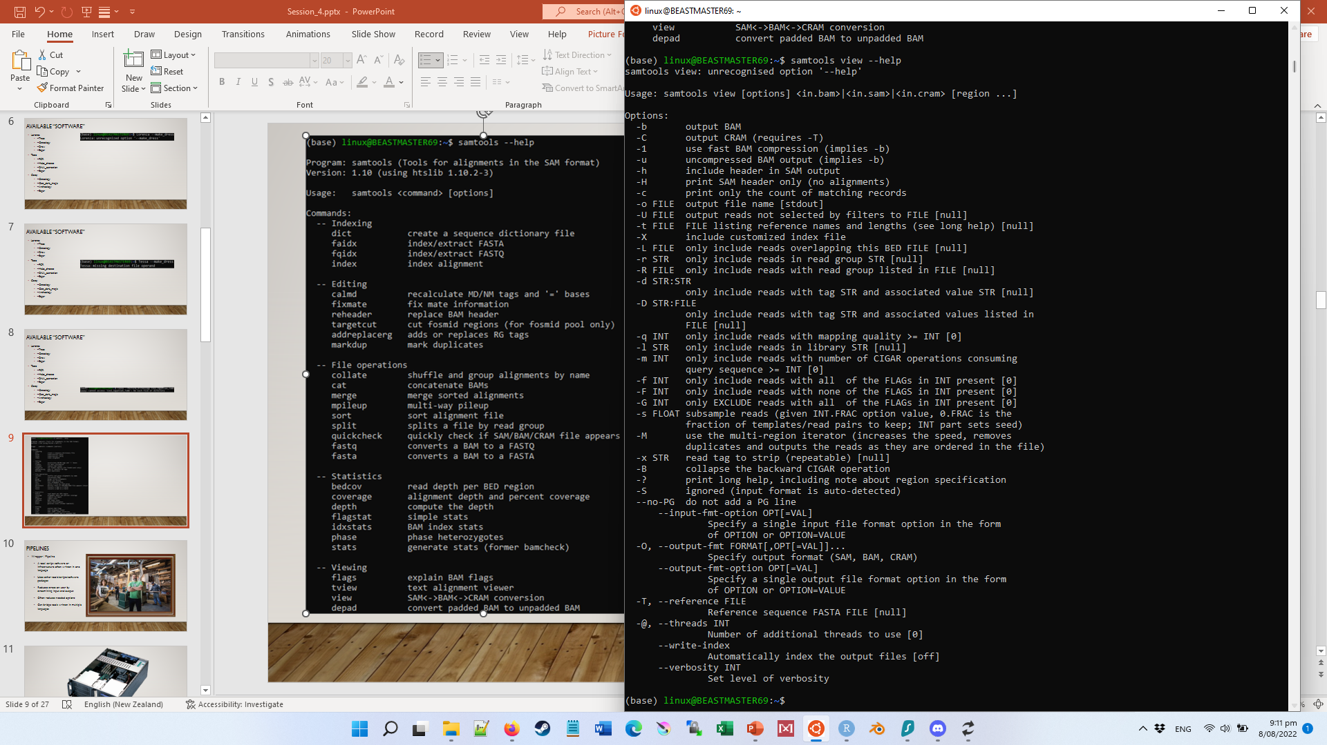

Slide 10
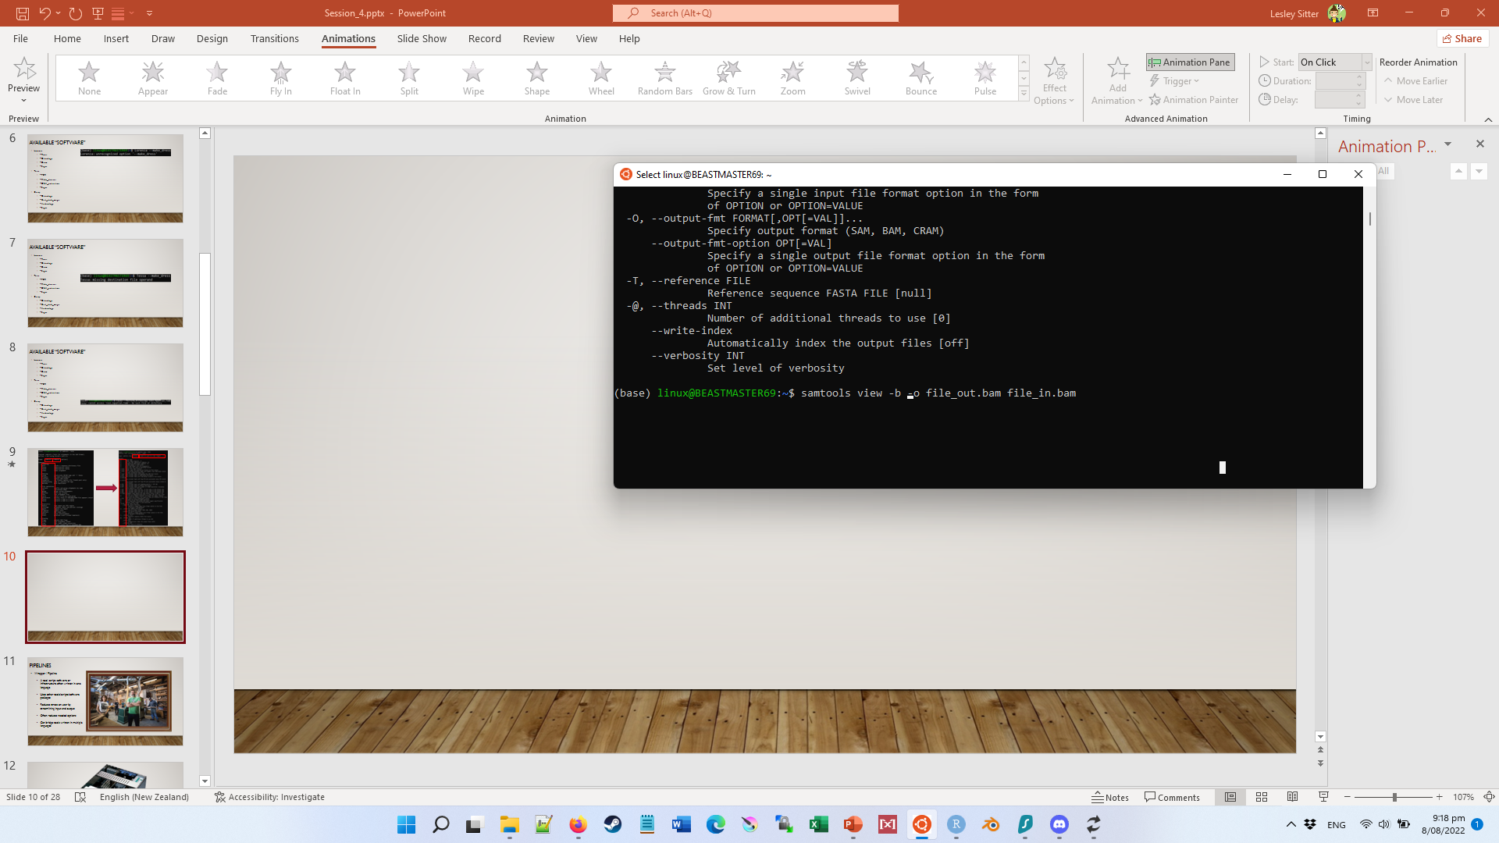
Running software
command line arguments
Software name
Command* (Argument 1)
Option 1 (Argument 2)
Argument 5
Option 2 (Argument 3 + 4)
*Most software doesn’t have this extra command layer

Slide 11

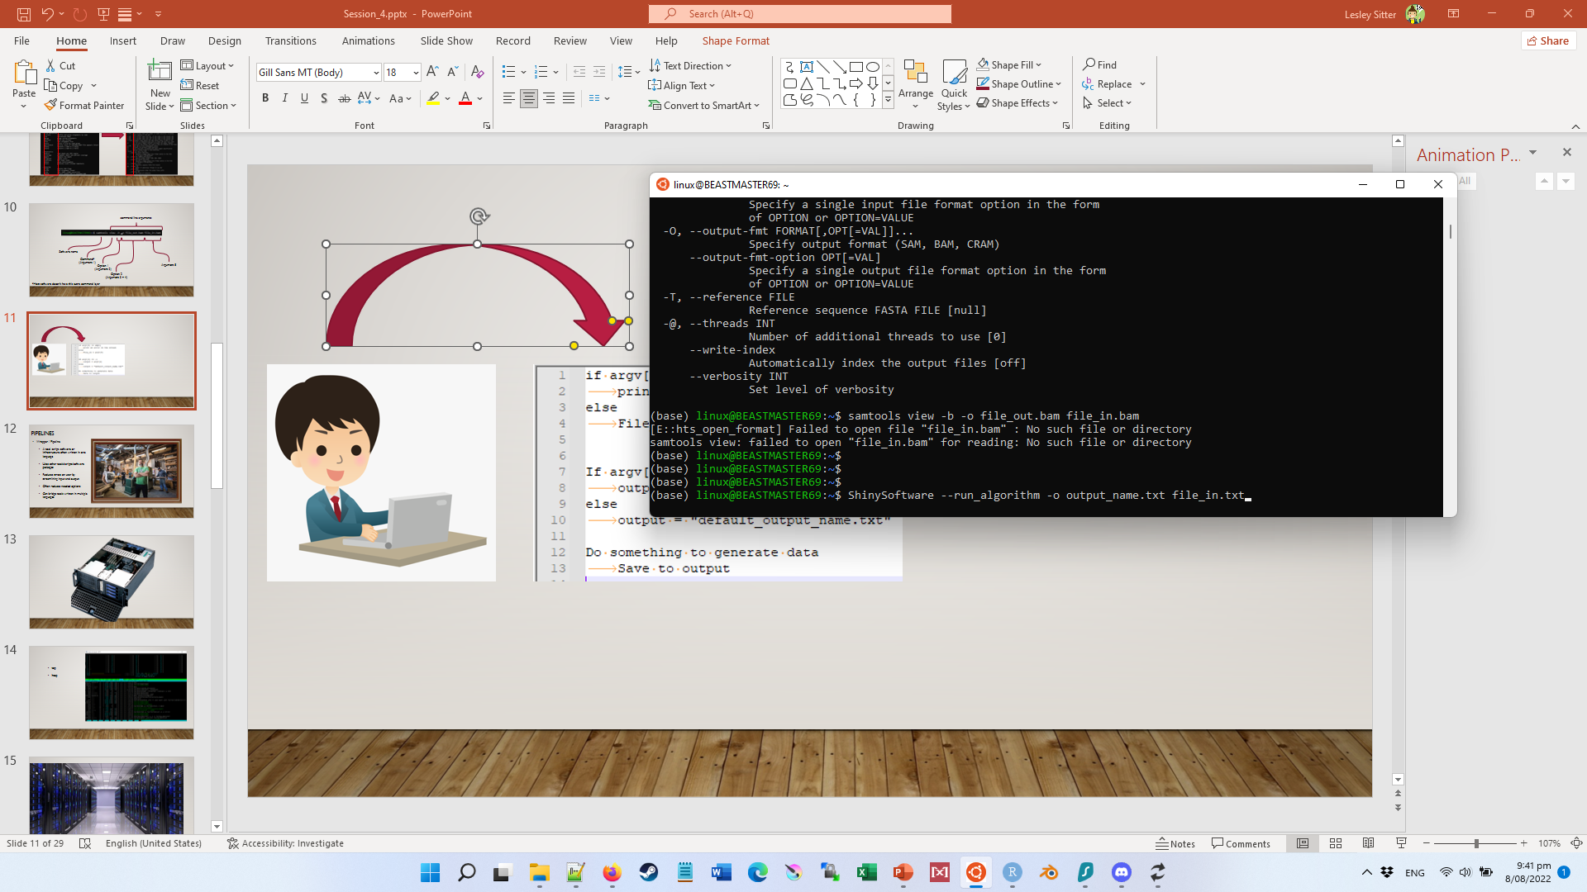
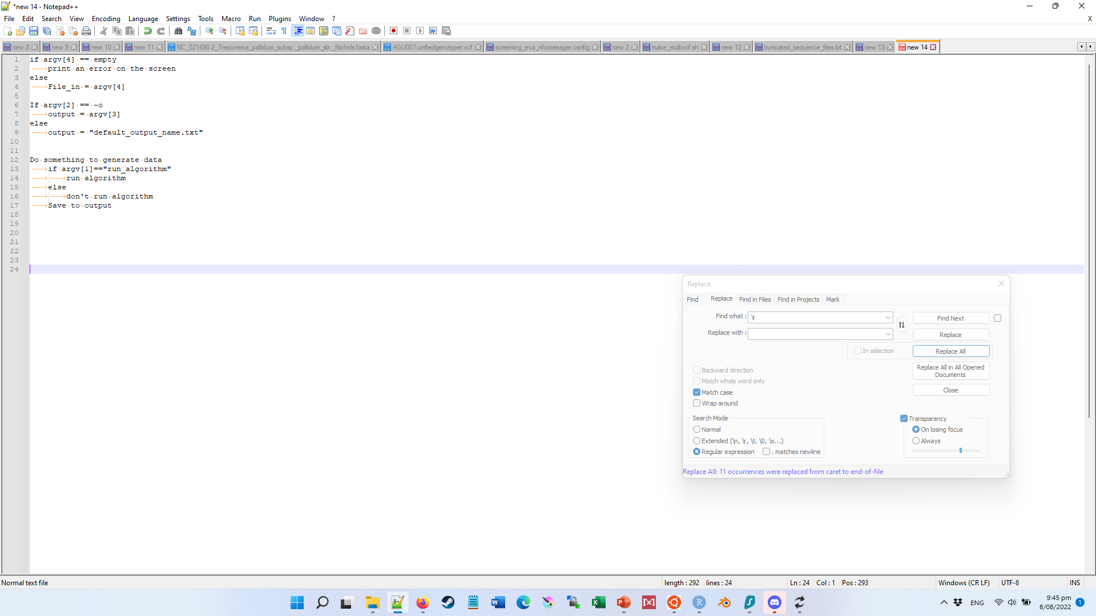
Pseudocode
Software name
Option 1 (Argument 1)
Option 2 (Argument 2 + 3)
Argument 4

Slide 12
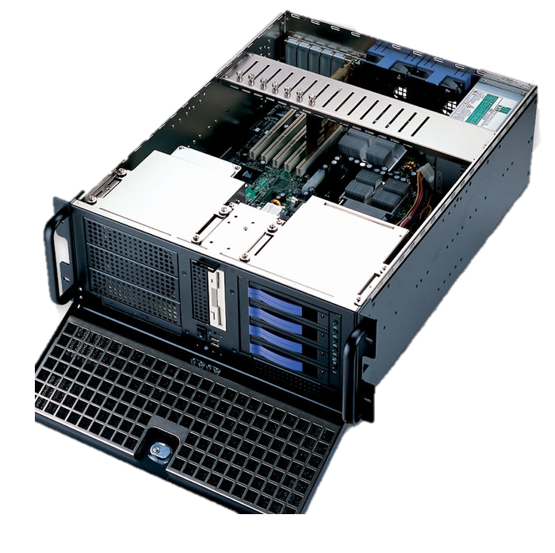


Slide 13
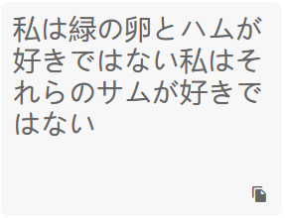
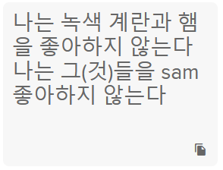
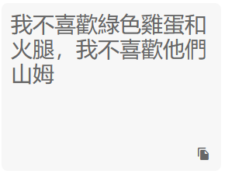
Scripts, scripting and “languages”
Japanese
Korean
Chinese (traditional)

Slide 14

Scripts, scripting and “languages”
Japanese
Korean
Chinese (traditional)
Chinese (simplified)

Slide 15

Scripts, scripting and “languages”

Slide 16
Scripts, scripting and “languages”
Language=Chinese
Language=Japanese
Language=Korean
Version=Traditional
Version=Simplified
Text.jpn
Text.Krn
Text.Chn
Text.Chn

Slide 17
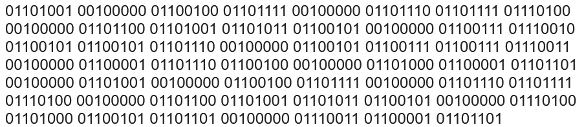
Scripts, scripting and “languages”
I do not like green eggs an ham, I do not like them Sam

Slide 18
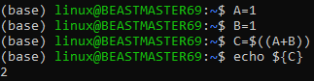
Scripts, scripting and “languages”
#usr/bin/language int A = 1;
int B = 1;
int C = A+B;
print(C)
Memory location “A” = 00110001
Memory location “B” = 00110001
Memory location “C” = Memory location “A” + Memory location “B” = 00110010 + 00110001 = 00110010
Convert content of Memory location “C” into ASCII variables, and tell the correct pixels to turn white.

Slide 19
Scripts, scripting and “languages”
JavaScript (not script for JAVA... confusing)
var x = 5;
console.log('x is ', x);
Java
int x = 5;
System.out.println(x);
Bash
x=5
echo "x is $x"
Perl
$x = 5;
print "$x";
R
x <- 5
x = 5
x
5

Slide 20
Scripts, scripting and “languages”
Python 2.7
print 'Hello, World!', variable_name
print 'Hello, World!'
print "Hello, ",
print "World!"
A = "Hello, "
B = "World!"
print A , B
Python >3
print('Hello, World!', variable_name)
print('Hello, World!')
print("some text,", end="")
print(' print more text on the same line')
A = "Hello, "
B = "World!"
print(A,B)
Hello, World!

Slide 21
Scripts, scripting and “languages”
Commandline
Header of script
Java –jar script.jar
Bash script.sh
Python script.py
Rscript script.r
#!/usr/bin/java
#!/usr/bin/bash #!/usr/bin/python3
#!/usr/bin/rscript
OR
Pseudocode
Software name
Option 1 (Argument 1)
Option 2 (Argument 2 + 3)
Argument 4

Slide 22
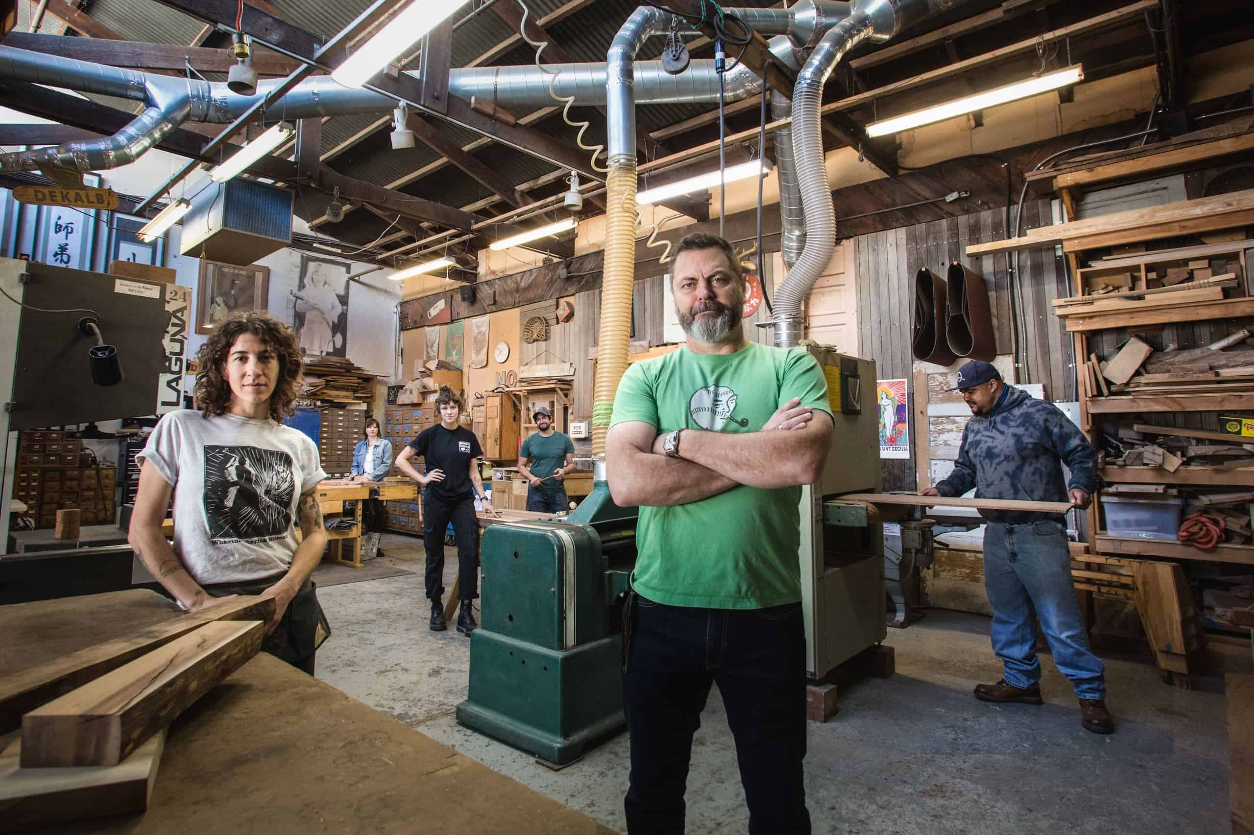
Pipelines
Wrapper / Pipeline
A tool, script, software or infrastructure often written in one language
Uses other tools/scripts/software packages
Reduces stress on user by streamlining input and output
Often reduces needed options
Can bridge tools written in multiple languages

Slide 23
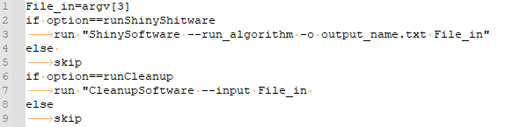
Pseudocode
Software name
Option 1 (Argument 1)
Option 2 (Argument 2 + 3)
Argument 4
Pipeline psuedocode
Software 1 psuedocode
Software 2 psuedocode
Pipeline name
Argument 1
Argument 2
Argument 3

Slide 25



Slide 26
bionc14 16CPU 503Gb
bionode01-06
64CPU 755Gb
bionc04 48CPU 503Gb
/mnt/archgen/
Permanent storage
bionc11 48CPU 1Tb
bionc13 48CPU 2Tb
bionode07-08
112CPU 2Tb
bionode27 128CPU 1Tb
bionode01-34
24CPU 47Gb
bionode35-67
32/36CPU
125-376Gb
/mnt/scratch/
Temporary hdd space meant for I/O heavy jobs
bio01-97
8CPU 15Gb
Not usable
all.q
all.q, archgen.q
Sun Grid Engine (SGE), using two different queus (all.q for everyone, archgen.q exclusively for us) qsub (queue submission)

Slide 28
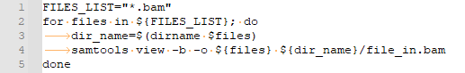
Running something successively
(locally)

Slide 29
Submitting to Queu
(parallel programming)

Slide 30
Cluster
Interactive session
qrsh
qsub
Change location
HeadNode Daghead1/2 Bionc21/22

Slide 31


